Slide 1
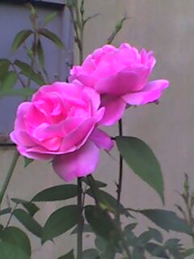
Welcome
1 M

Slide 2
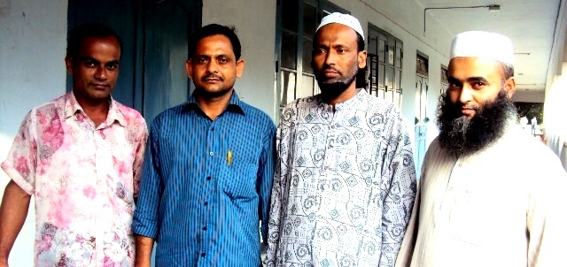
Introduction
Anwarul Islam
Assistant Teacher (English)
Annada Govt. High School Brahmanbaria
ID No: 10 Batch No: 5
Class: Six Time: 40 Minutes
Contact # 01715456452

Slide 3
Objectives:
After the lesson students will be able to-
identify present continuous tense.
use the structure of present continuous tense to form sentences.
use present continuous tense in proper situation.

Slide 4
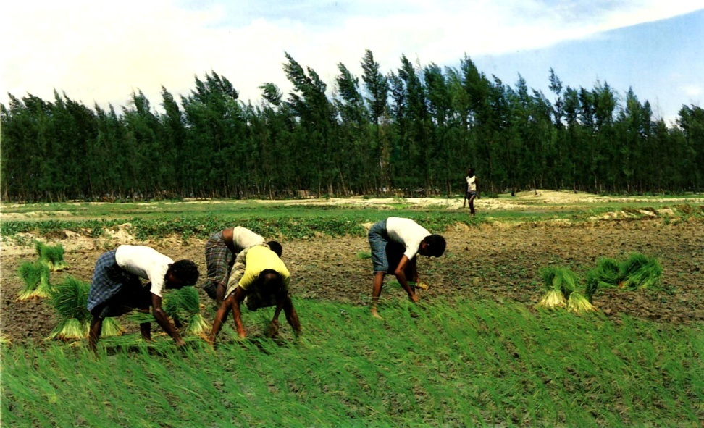
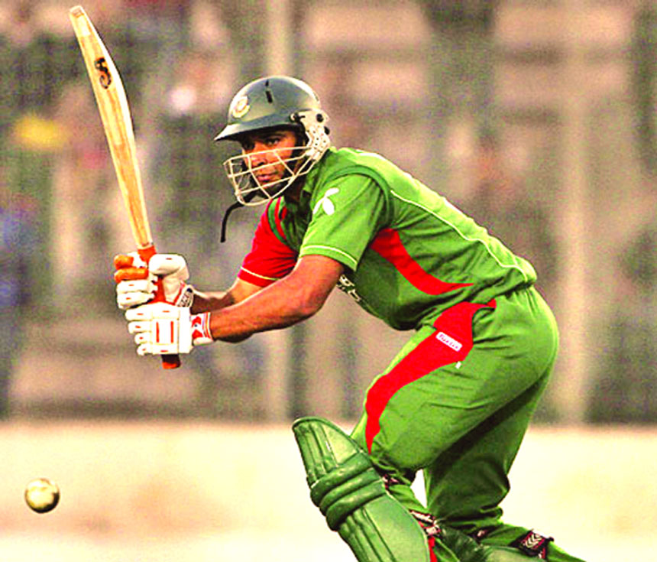
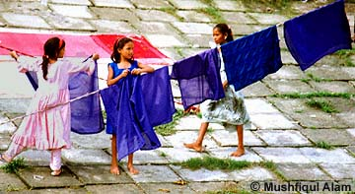
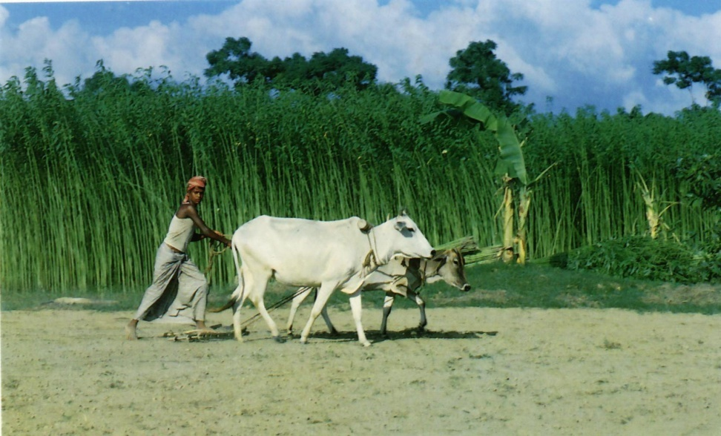
Playing cricket
Drying clothes
Cultivating land
Planting paddy
A
3 M
C
B
D

Slide 5
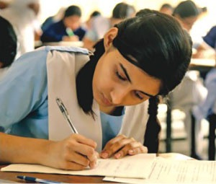
What is she doing?
She is writing.

Slide 6

Present Continuous Tense
2 M
What is he doing?
He
is reciting
the holy Quran.

Slide 7
Present Continuous Tense
They are drying clothes.

Slide 8

Present Continuous Tense
He is cultivating his land.

Slide 9
Present Continuous Tense
He is playing cricket.

Slide 10

Present Continuous Tense
They are planting paddy.

Slide 11
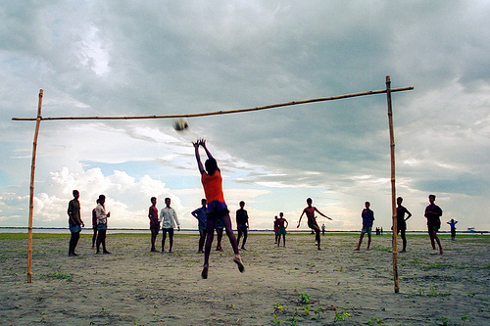
Present Continuous Tense
They are playing football.

Slide 12
Present Continuous Tense
From the sentences have you understood how to form present continuous tense?
Subject
Verb
Object
They
are playing
football

Slide 13
Present Continuous Tense
Structure of Present Continuous Tense
Subject | Verb |  | Object
 | Be verb | Ing form of PV | English.
I | am | teaching
He / She | is | learning
We/You They | are

Slide 14
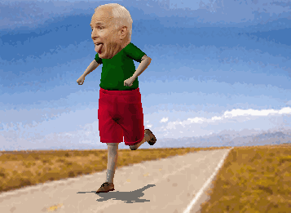
Is he walking?
No, he is not walking.

Slide 15
Present Continuous Tense
If the sentence is negative structure of Present Continuous Tense will be:
Subject | Verb |  |  | Object
 | Be verb | not | Ing form of PV | English.
I | am |  | teaching
He / She | is |  | learning
We/You They | are

Slide 16
Present Continuous Tense
From the pictures have you understood when to use present continuous tense?
We use present continuous tense to describe an action that is happening at this moment.

Slide 17
Correct the following sentences:
Individual Work 5 M
I is speaking English.
You am learning English.
He are taking tea.
Samin am enjoying the match.
The boys are swim in the pond.
am
are
is
is
swimming

Slide 18
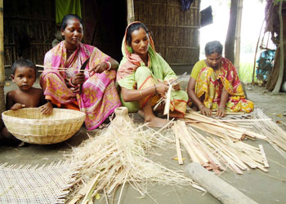
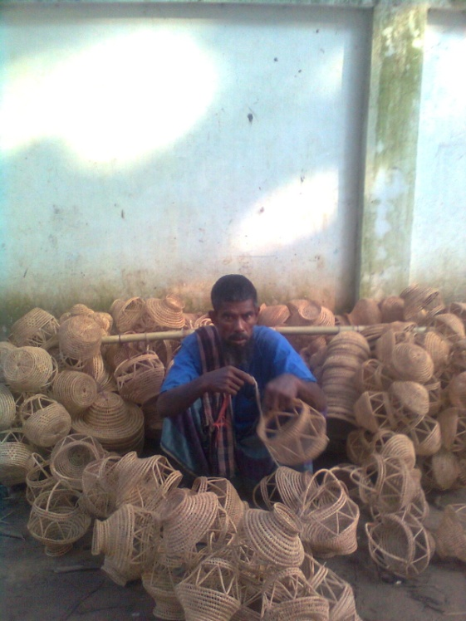
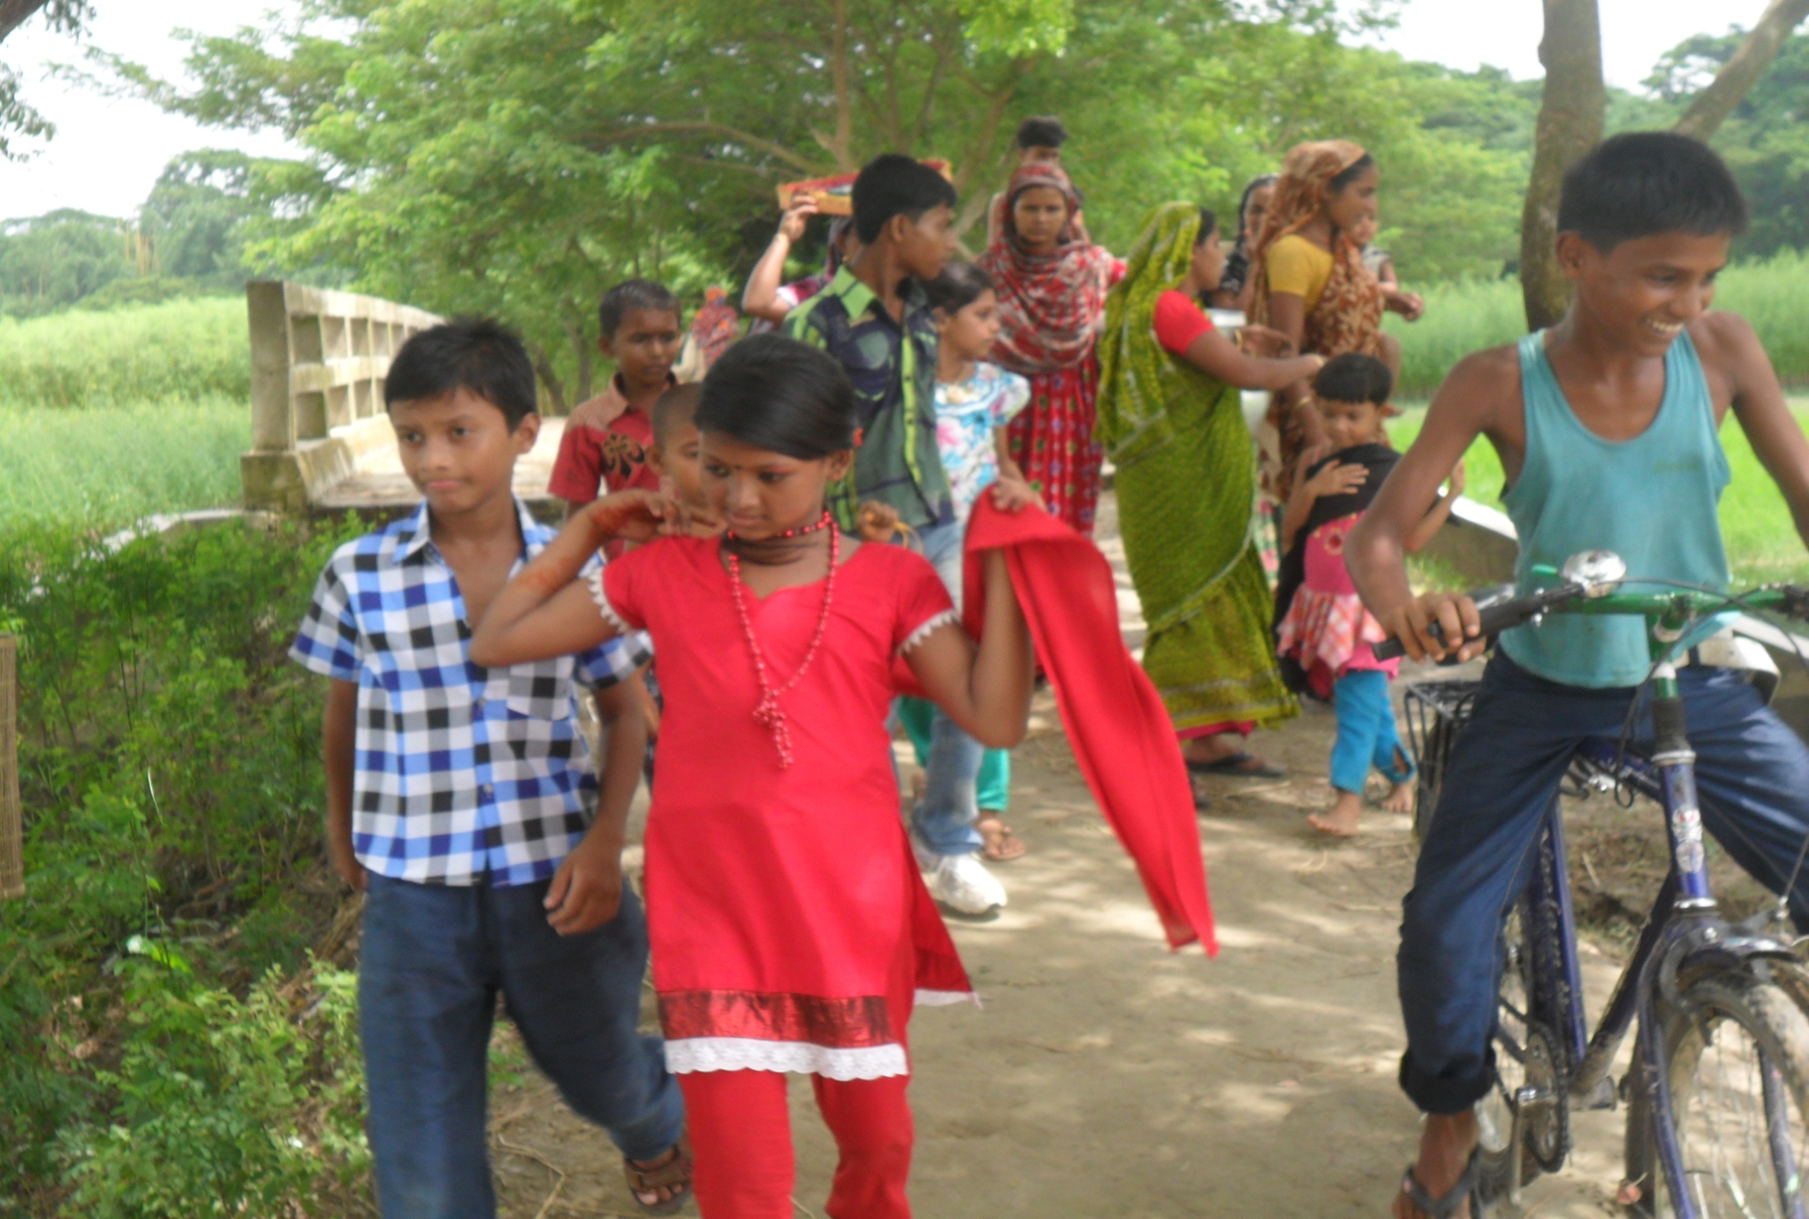
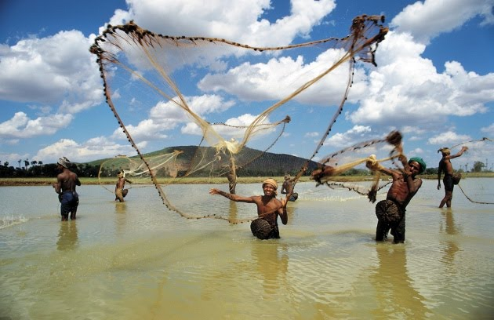
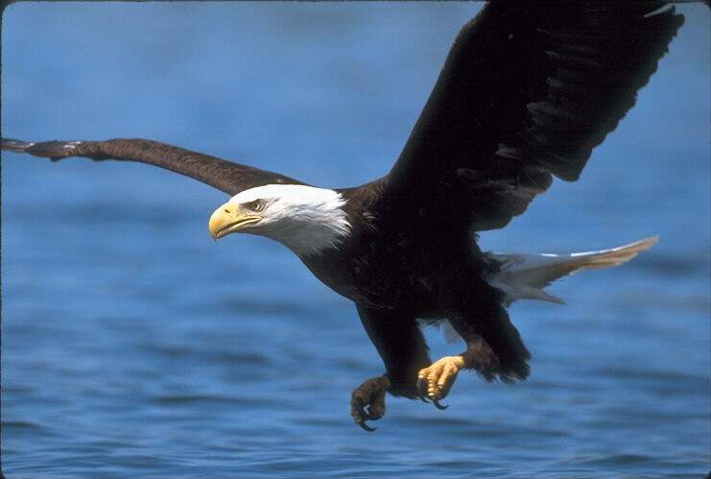
Make sentences using the following clues:
Group Work 5 M
sell
make baskets
catch fish
fly
ride a bi-cycle

Slide 19
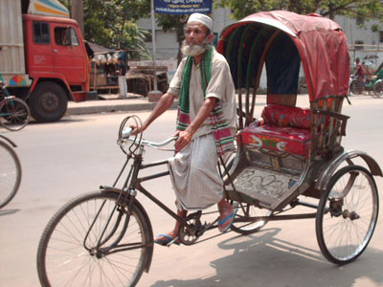
Make true sentences about the picture using the clues. Use am, is or are and not if necessary.
He/ pull/ a rickshaw
He/ drive/ a car.
He/ wear/ a tupi.
He/ walk.
He/ wear/a lungi.
He/ sell/ rickshaws.

Slide 20
Home Work
Write 10 sentences in present continuous tense about the things that will happen around you at home.

Slide 21

Thanks

